Slide 1
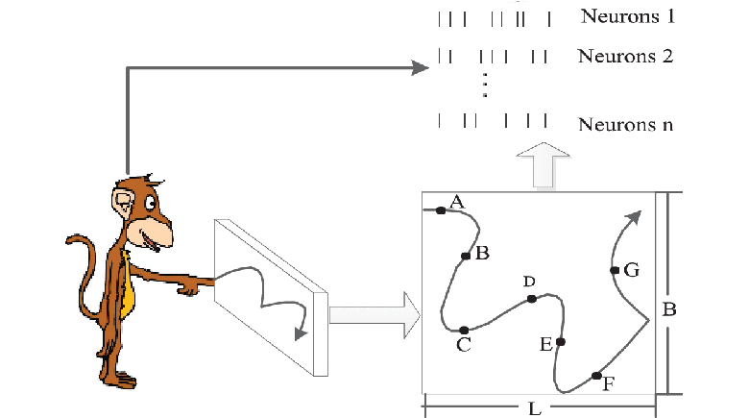
ROBUST NEURAL DECODING UNDER MISSING CHANNELS
Presented By:
Kartavya Mandora
Date: 05/06/2026
https://www.embs.org/wp-content/uploads/2019/03/feng1-2893406-hires.gif
AI689_SPRING2026

Slide 2
OUTLINES
Problem Overview
Dataset Overview
Problem Formulation
Methodology
Key Experiments
Results
Key Insights
Conclusion & Future work

Slide 3
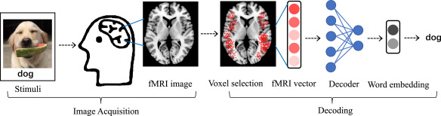
PROBLEM OVERVIEW
Neural decoding = brain → movement
Applications:
Prosthetics
Assistive tech
Challenge:
Noisy signals
Missing channels
https://ars.els-cdn.com/content/image/1-s2.0-S0020025519307820-gr1.jpg

Slide 4
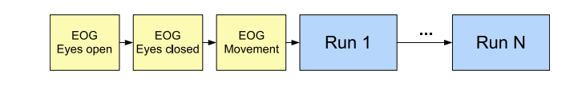
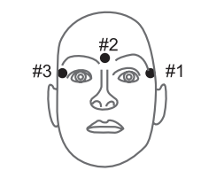
DATASET OVERVIEW
Dataset: BCI Competition IV Dataset 4
62 channels
Output: 5 finger positions
Subjects: S1, S2, S3
Time-series data
R. Leeb et al. BCI Competetion 2008

Slide 5
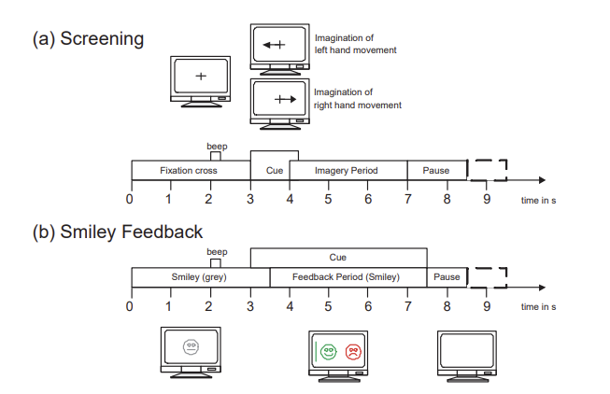
PROBLEM FORMULATION
Input: neural signals (62 channels)
Output: finger positions (5 values)
Type: Regression problem
Metric: R² score
R. Leeb et al. BCI Competetion 2008

Slide 6
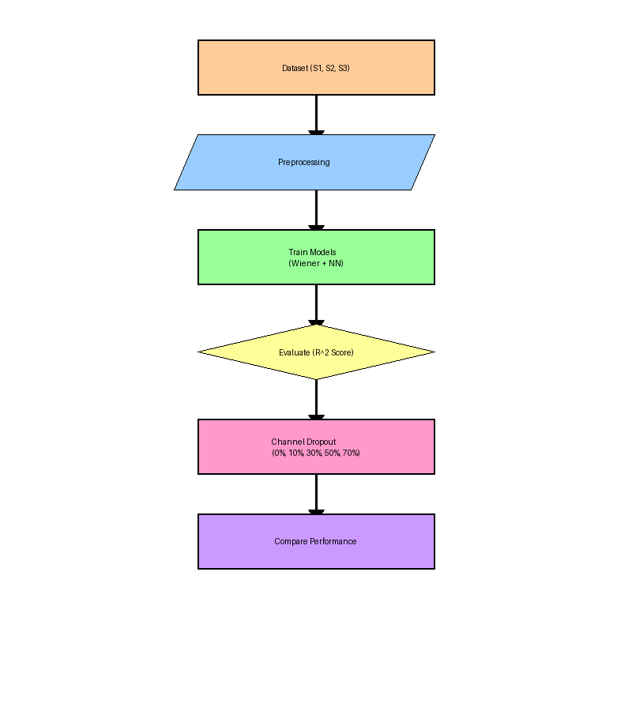
METHODOLOGY
Models:
Wiener Filter (Linear)
Neural Network (Nonlinear)
Preprocessing:
StandardScaler
Experiment:
Channel Dropout (0% → 70%)

Slide 7
KEY EXPERIMENT
Channel dropout levels:
0%, 10%, 30%, 50%, 70%
Goal:
Test robustness
Compare:
Wiener vs Neural Network

Slide 8
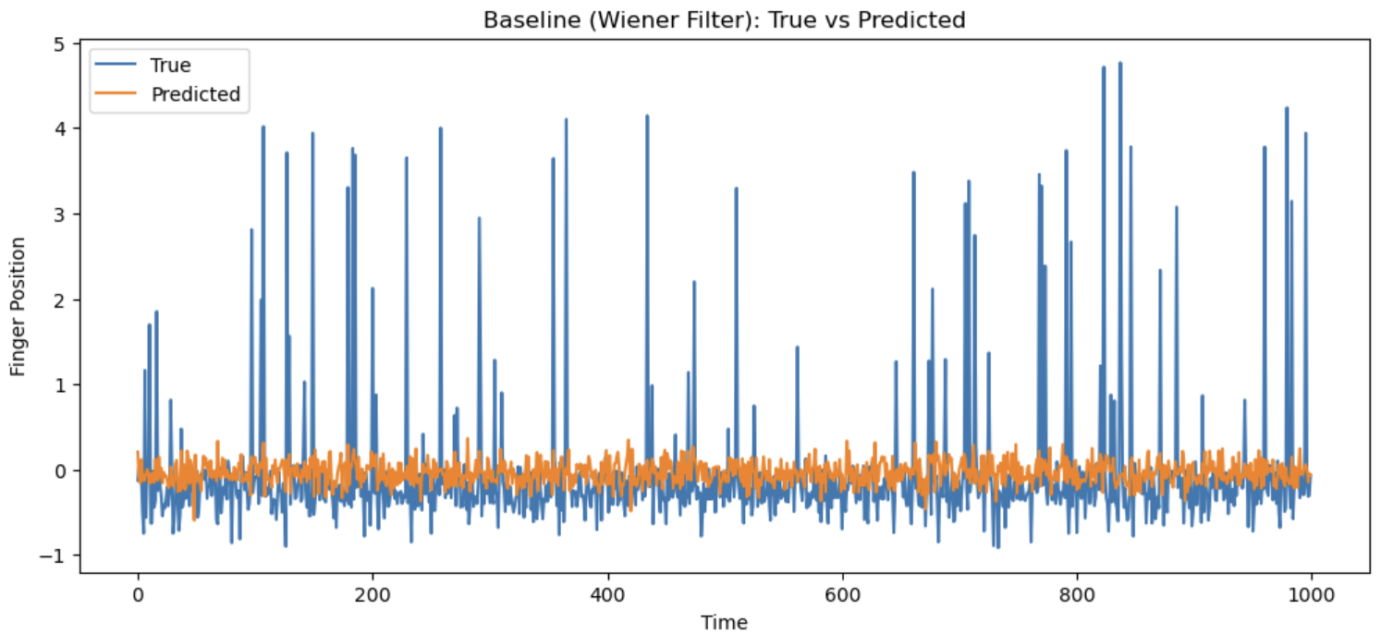
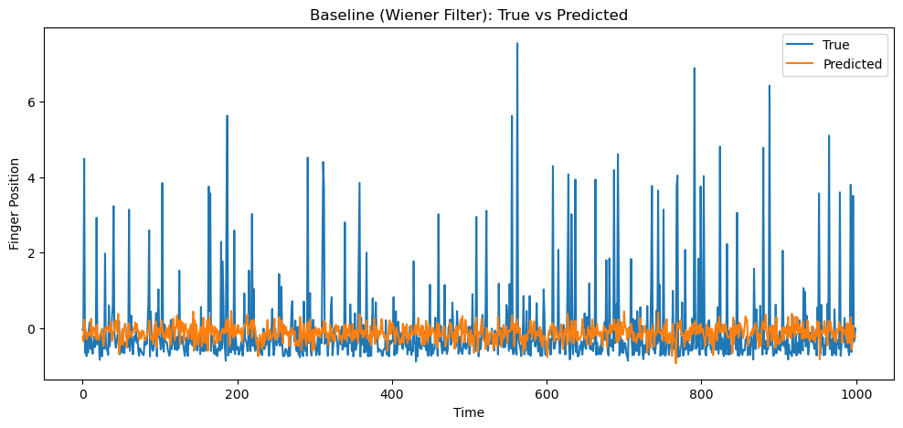
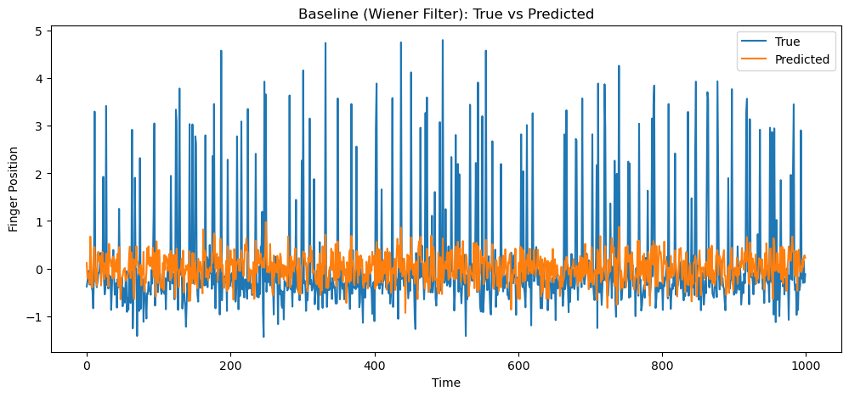
RESULTS
Wiener Filter True Vs Predicted graph (for S1, S2 and S3)

Slide 9
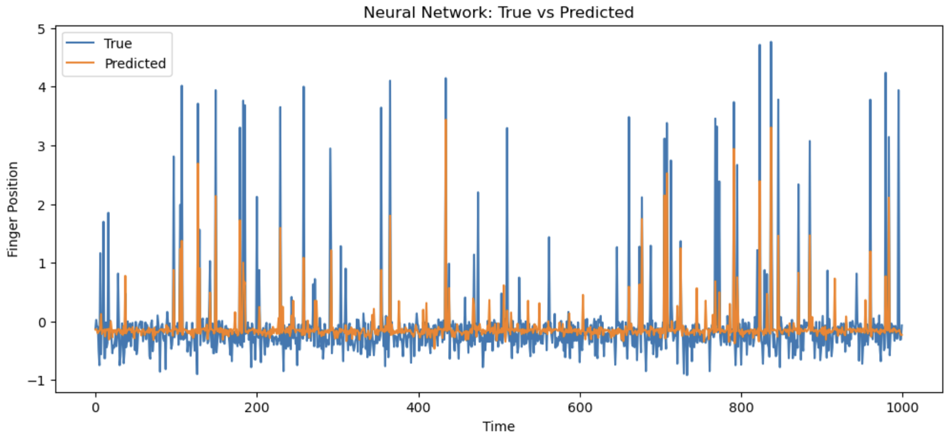
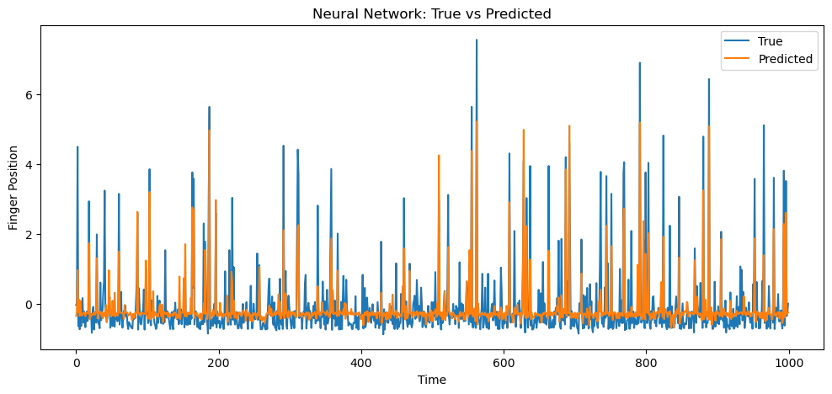
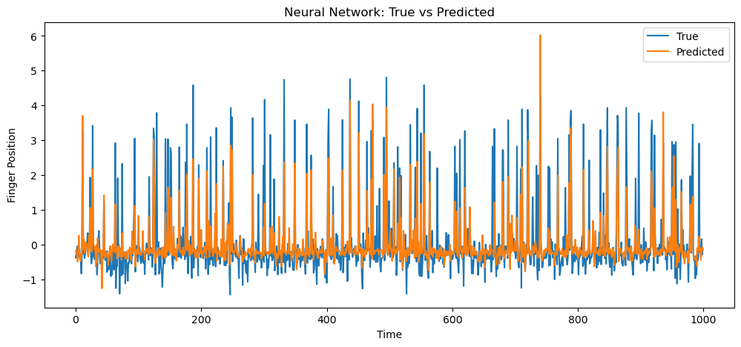
RESULTS
Neural Network True Vs Predicted graph (for S1, S2 and S3)

Slide 10
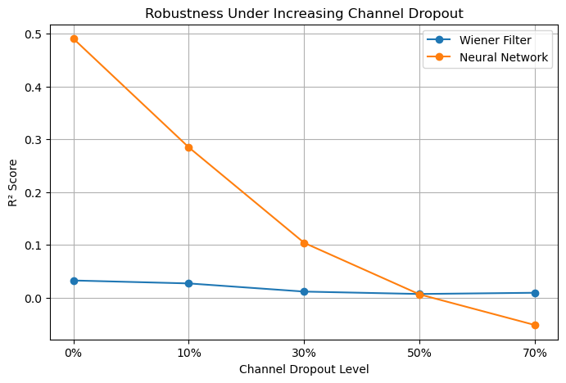
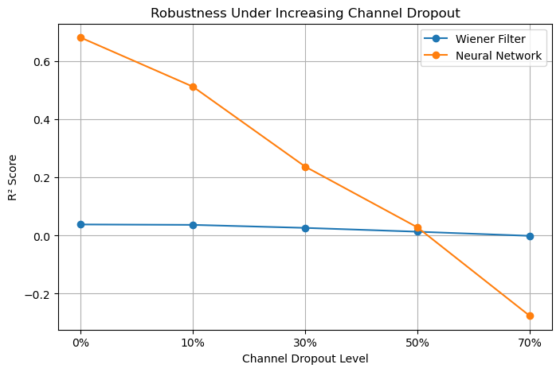
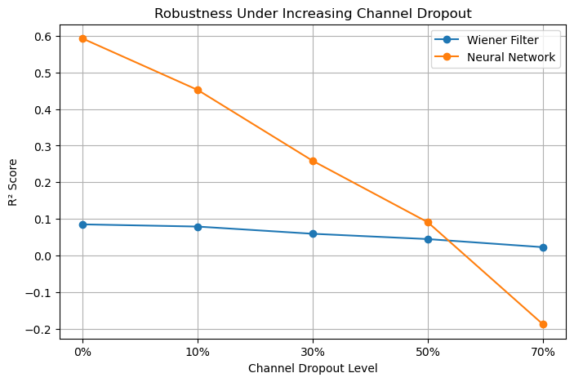
RESULTS
NN strong at low dropout
Drops at high dropout
Wiener always low
Robustness under increasing channel dropout (for S1, S2 and S3)

Slide 11
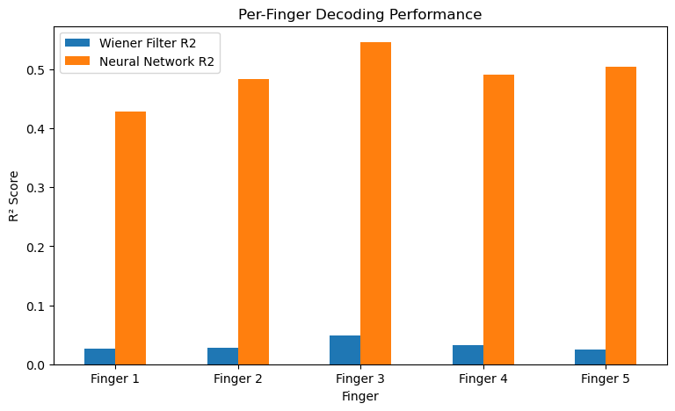
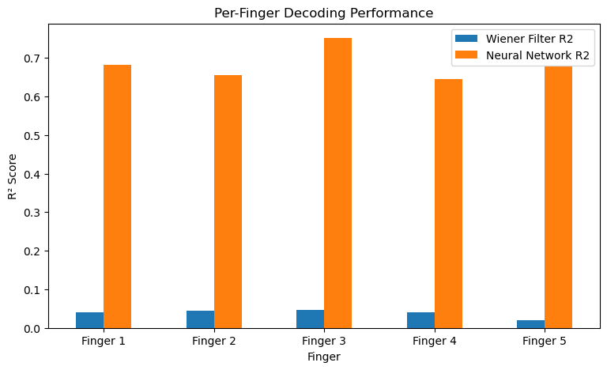
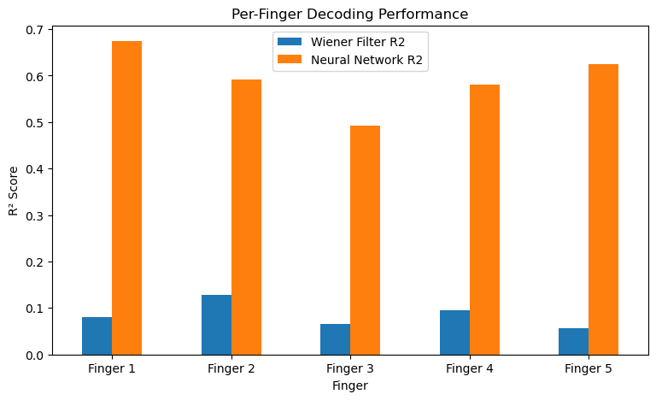
RESULTS
NN better for all fingers
consistent advantage
Plot of Per Finger Decoding Performance (for S1, S2 and S3)

Slide 12
RESULTS
Dropout Level | S1 Wiener R² | S1 NN R² | S2 Wiener R² | S2 NN R² | S3 Wiener R² | S3 NN R²
0% | 0.032 | 0.491 | 0.038 | 0.682 | 0.085 | 0.593
10% | 0.027 | 0.285 | 0.037 | 0.513 | 0.079 | 0.452
30% | 0.011 | 0.104 | 0.027 | 0.238 | 0.059 | 0.258
50% | 0.007 | 0.006 | 0.013 | 0.029 | 0.045 | 0.091
70% | 0.009 | -0.052 | -0.001 | -0.276 | 0.023 | -0.188
NN >> Wiener
Consistent across S1, S2, S3
Finger | S1 (R²) |  | S2 (R²) |  | S3 (R²)
 | Wiener | NN | Wiener | NN | Wiener | NN
F1 | 0.027 | 0.429 | 0.041 | 0.682 | 0.080 | 0.674
F2 | 0.028 | 0.483 | 0.045 | 0.656 | 0.128 | 0.591
F3 | 0.048 | 0.546 | 0.046 | 0.752 | 0.066 | 0.493
F4 | 0.033 | 0.491 | 0.040 | 0.645 | 0.095 | 0.580
F5 | 0.026 | 0.504 | 0.020 | 0.678 | 0.056 | 0.625

Slide 13
KEY INSIGHTS
NN performs best
Performance ↓ with dropout
Challenges:
High dimensionality
Nonlinear mapping
Missing channels
Robustness strategies:
Nonlinear models
Dropout training

Slide 14
CONCLUSION & FUTURE WORK
NN > Wiener
Robust under moderate dropout
Limitations:
High dropout failure
Future Work:
RNN implementation
Data augmentation
Better robustness methods

Slide 15
THANK YOU!!
Questions

